Slide 1
Medical Diagnosis System Using Support Vector Machine

Slide 2
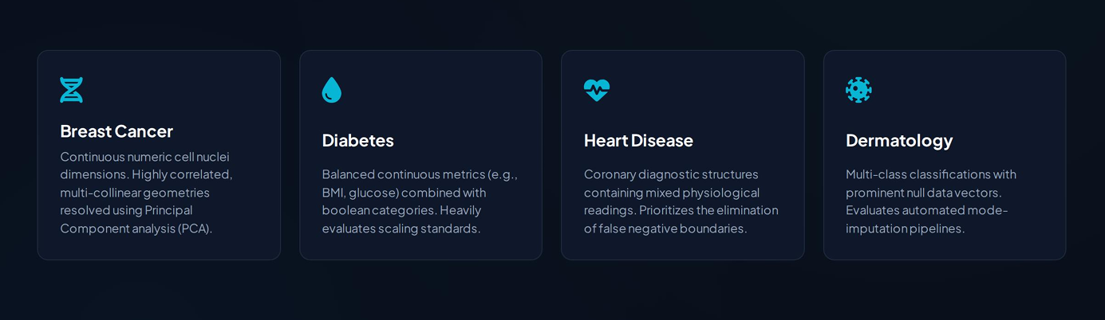
|
Objective
Build a System to classify disease from medical data
|
Datasets

Slide 3
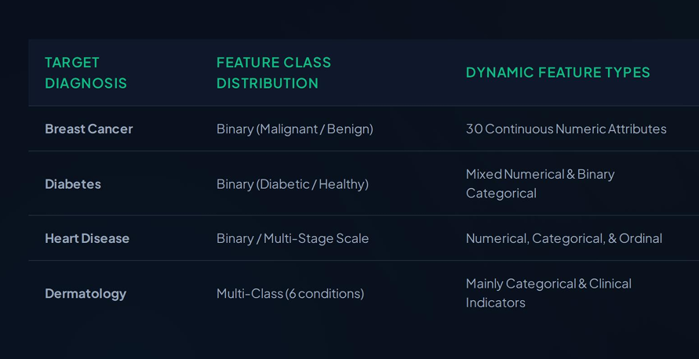
|
Dataset Characteristics matrix

Slide 4
|
Data Preprocessing
Missing Value Handling
Missing Numeric values are replaced by respective feature mean
Missing categorical values are replaced by respective feature frequent value
2. Feature Scaling
Numerical data are transform within same Distribution using standard Scaler
#
Scaling prevents features with larger numeric ranges from dominating distance calculations in algorithms like SVM.

Slide 5
3. Encoding
Categorical entries are encoded to numerical values using OneHotEncoder
#
Algorithm works well when numerical data is feed to it
4 Imbalance Handling
Medical datasets are frequently imbalanced, as healthy patient records often outnumber positive disease cases.
SMOTE is applied during preprocessing to synthetically balance the training classes.
This prevents the SVM classifier from developing a bias toward the majority class

Slide 6
|
Principal Component Analysis
Medical datasets often contain highly correlated and high-dimensional features, which can lead to overfitting and slow down distance-based estimators like SVM.
To mitigate this, we integrate Principal Component Analysis (PCA) into our preprocessing pipeline.
PCA transforms the standardized data into a set of linearly uncorrelated principal components.
By selecting the top components that capture the maximum variance, we eliminate noisy or redundant features thereby Refining SVM decision boundary and improving classification efficiency.

Slide 7
|
Model Training
SVM model is trained over the training data using standard sklearn library
Processed data is split into train and test data
Model is evaluated on the Test Data and hence the result of corresponding datasets are recorded
Hyperparameter are tunned for svm model and PCA component using Grid search CV.

Slide 8
|
Hyperparameter Tunning
Hyperparameter are Tunned using GridSearchCV present in Sklearn library
Folllowing hyperparameter are tunned
Kernal attribute : ["linear", "rbf", “polynomial”]
2. Gamma : ["scale", "auto"]
SVM Hyperparameter
3. C : [0.1, 1, 10]
4. n_components : [5, 10]
PCA Hyperparameter

Slide 9
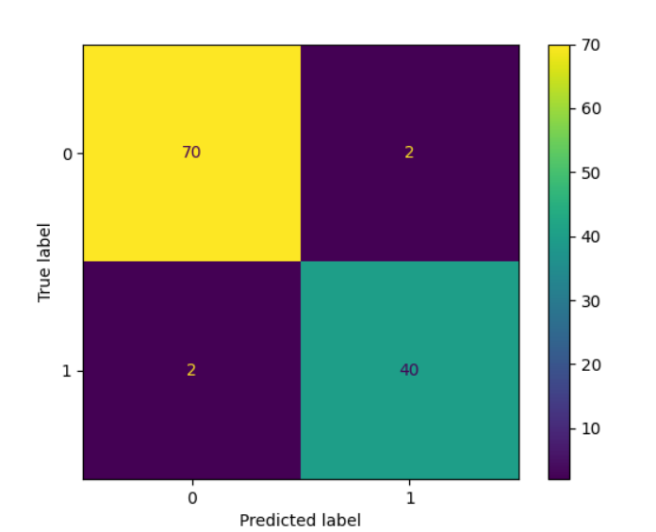
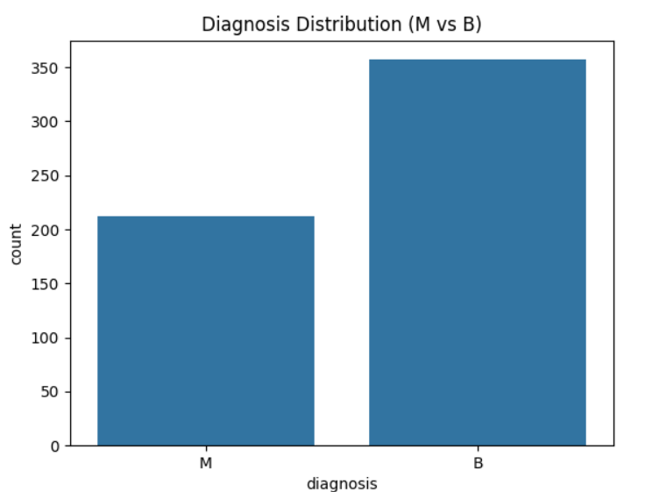
|
Results and Visualization
I. Breast Cancer Dataset

Slide 10
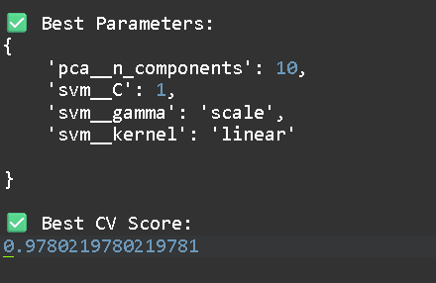
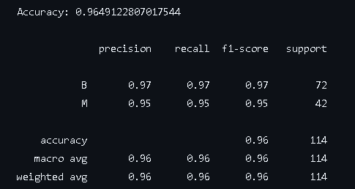
Parameter Selected via GridSearchCv
Classification Metrics

Slide 11
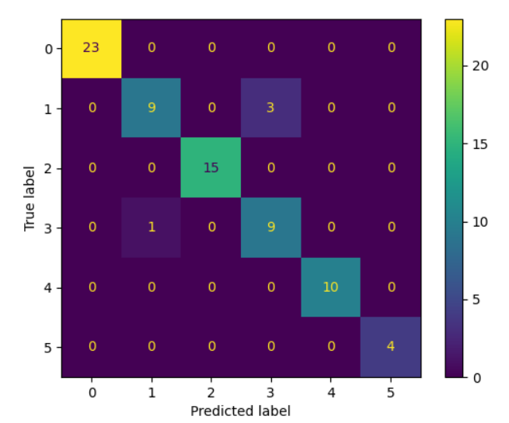
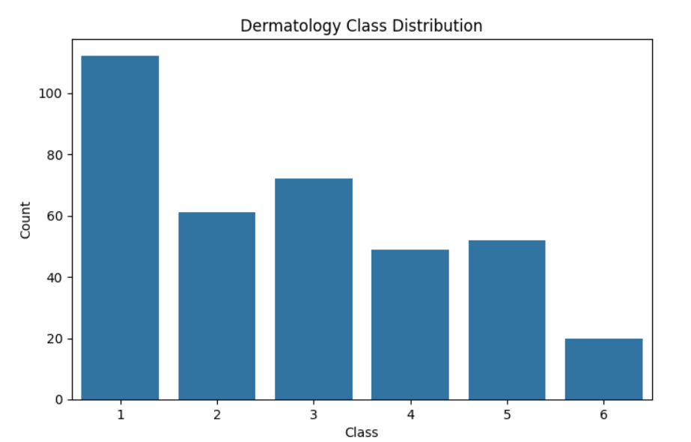
II. Dermatology Dataset

Slide 12
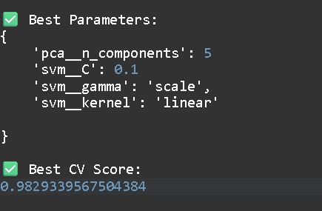
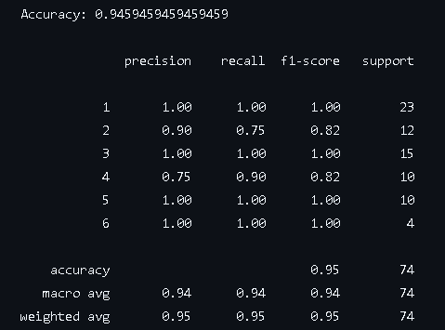
Parameter Selected via GridSearchCv
Classification Metrics

Slide 13
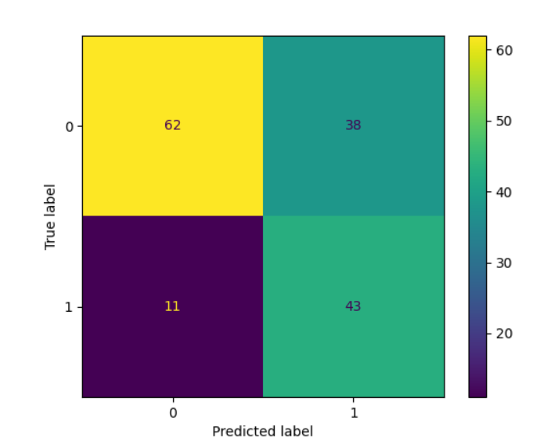
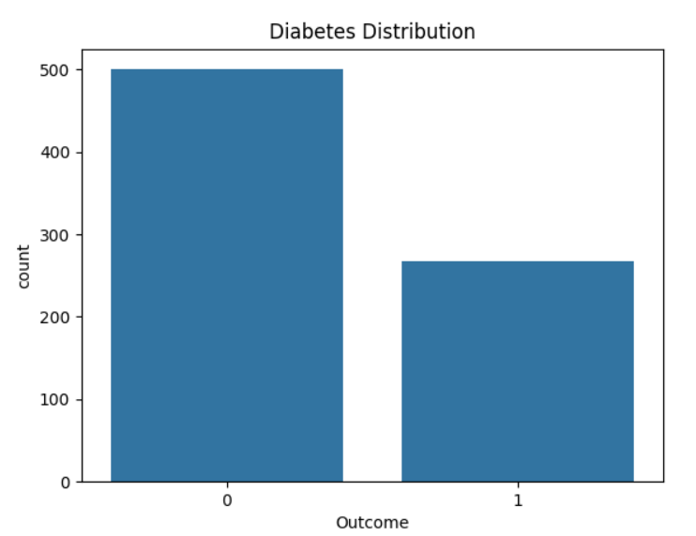
III. Diabetes Dataset

Slide 14
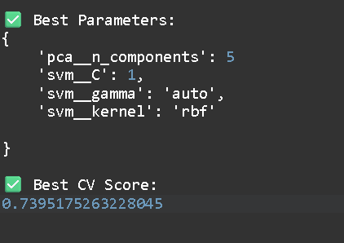
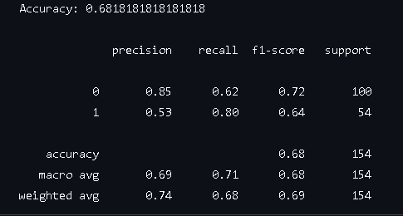
Parameter Selected via GridSearchCv
Classification Metrics

Slide 15
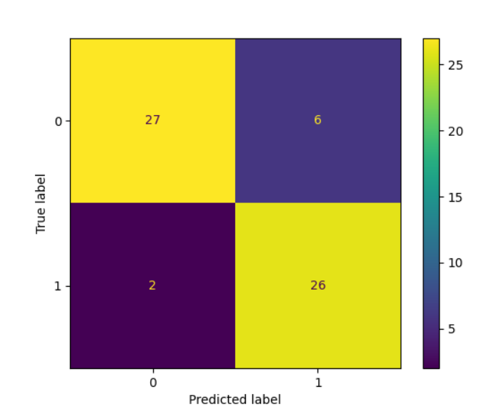
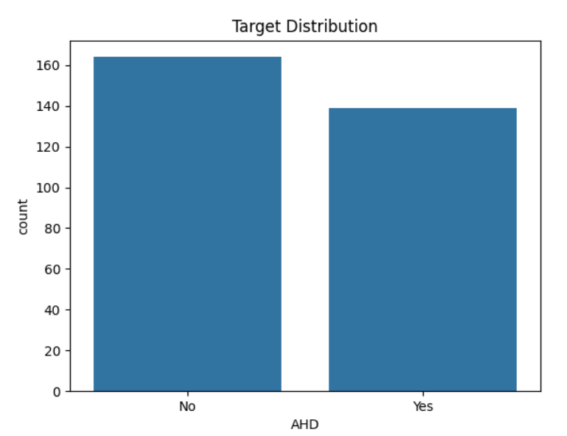
IV. Heart Disease Dataset

Slide 16
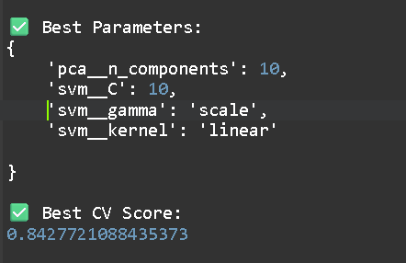
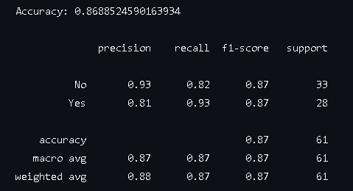
Parameter Selected via GridSearchCv
Classification Metrics

Slide 17
Presented by
Satyam Jalvi
Srijan Singh
Narayan Ram
Sahil Mandalwar
Thank You

